Slide 1

Job Market
Analysis
for Data Professionals in Germany
Mahammadali Rzayev​
Sebastian Spratz​
Pakin Veerachanchai

Slide 2
Objectives
01
02
Analyze
Explore
the demand for specific skills, qualifications, and experiences required for Data Engineer and Data Scientist positions in Germany.​
factors contributing to the job appeal within the German market.

Slide 3
Implementation Plan
01
02
03
Project Initialization
Data Collection
Analytics
Formalize project objectives and finalize the list of job boards as data sources.
Web scraping
Data cleaning
Trend analysis
Insight extraction
Effective data visualization.

Slide 4










Implementation Update
Selenium
Data Collection

Slide 5

Data Structure

Slide 6
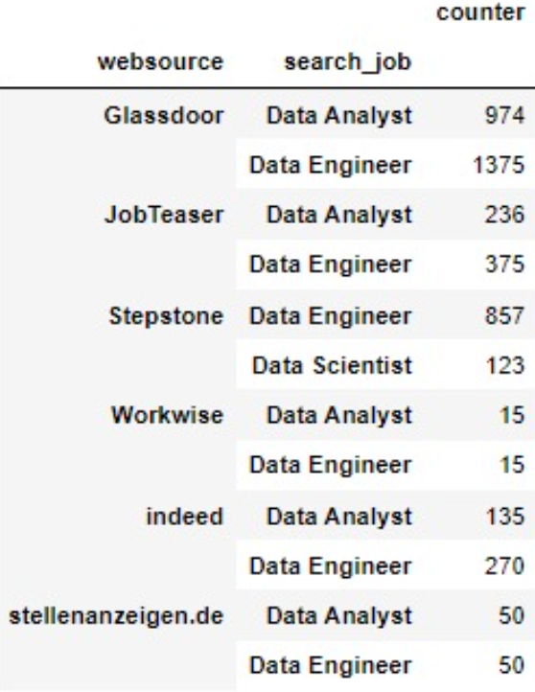
Insight extraction

Slide 7
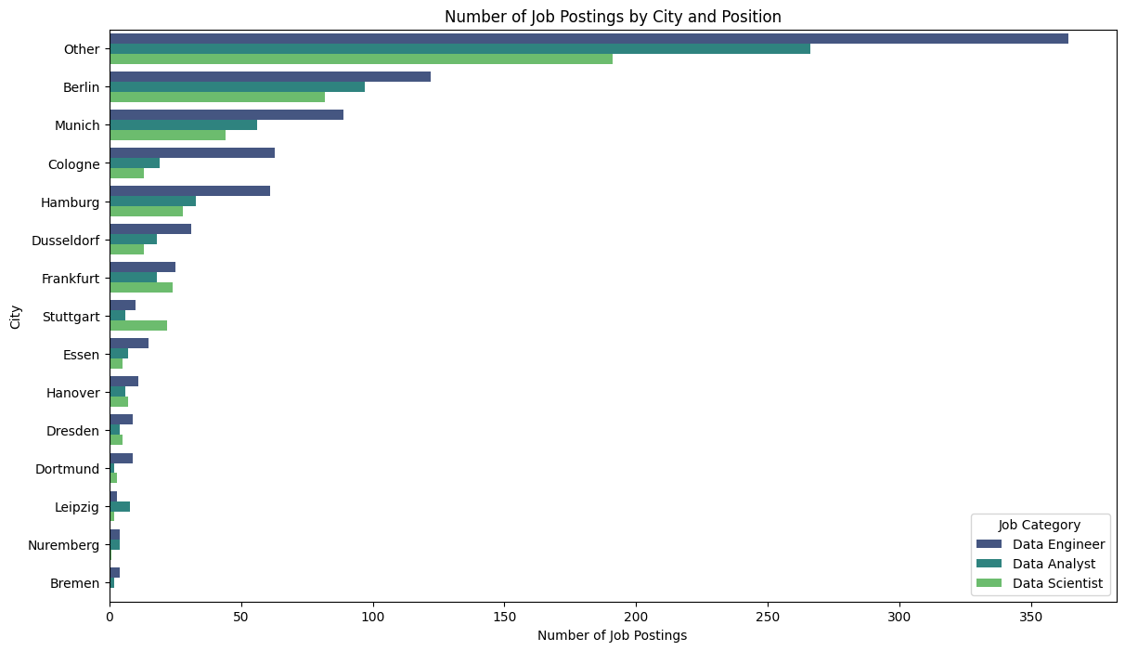
Insight extraction

Slide 8
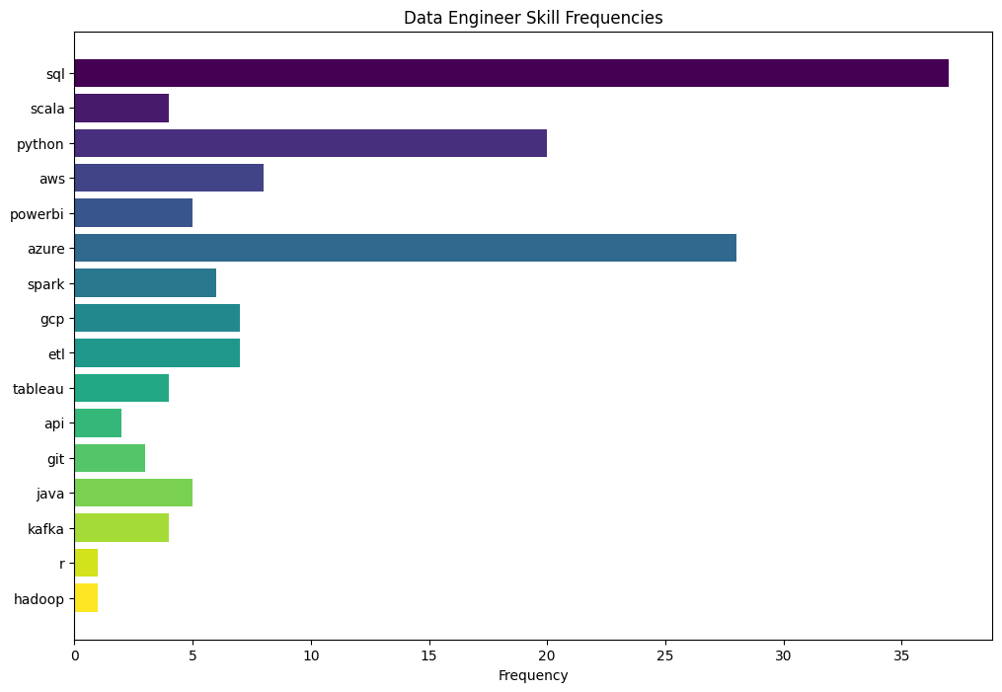
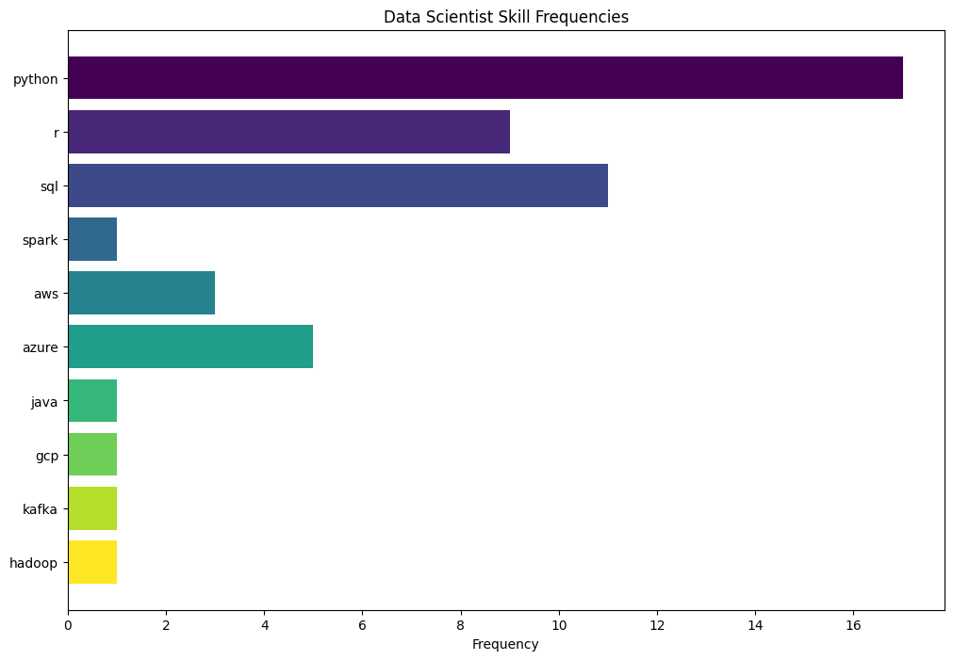
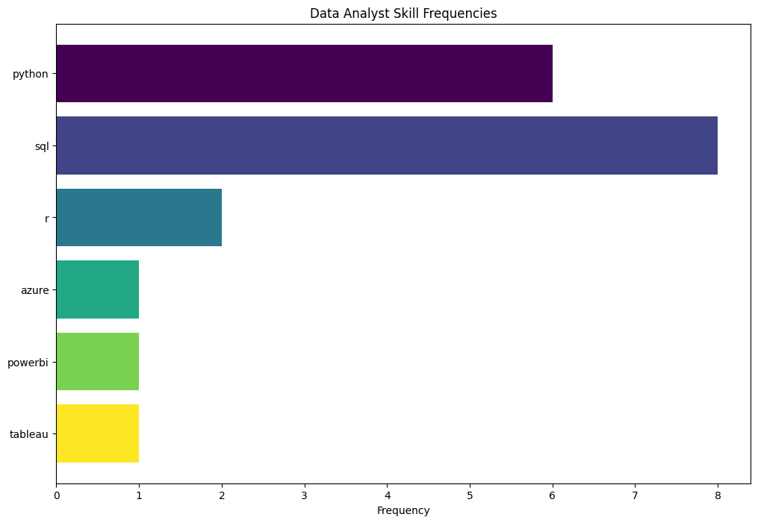
Technical Skills
Data Engineer
Data Scientist
Data Analyst

Slide 9
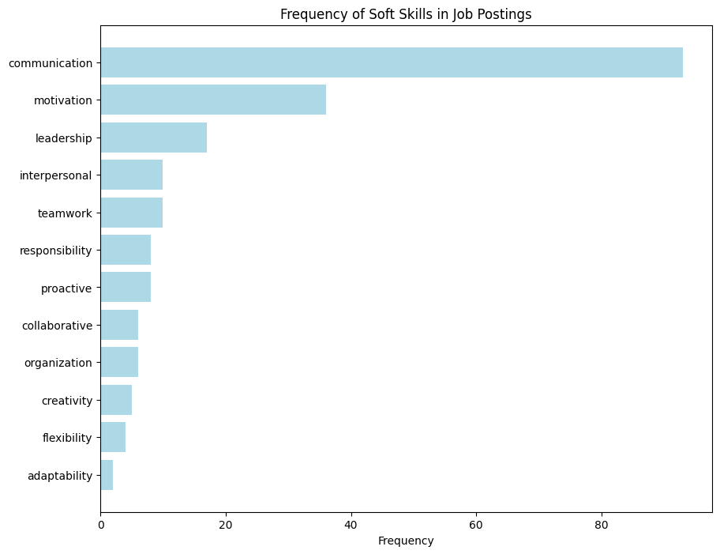
Soft Skills

Slide 10
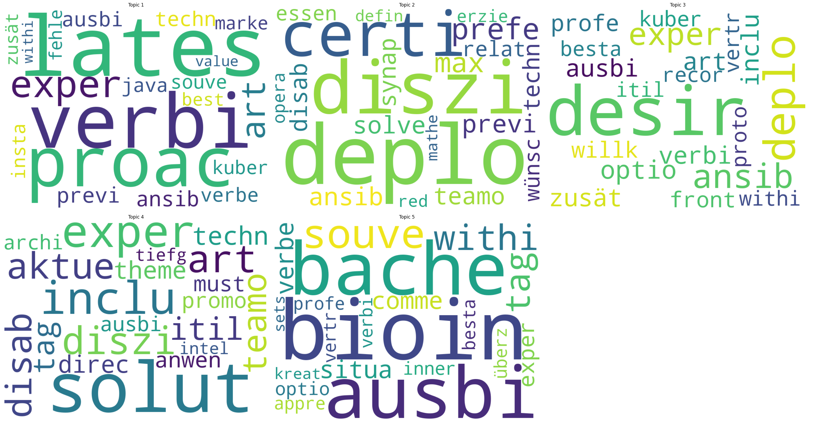
Job Description
Experience?
Technical?
Non-negative Matrix Factorization (NMF)

Slide 11
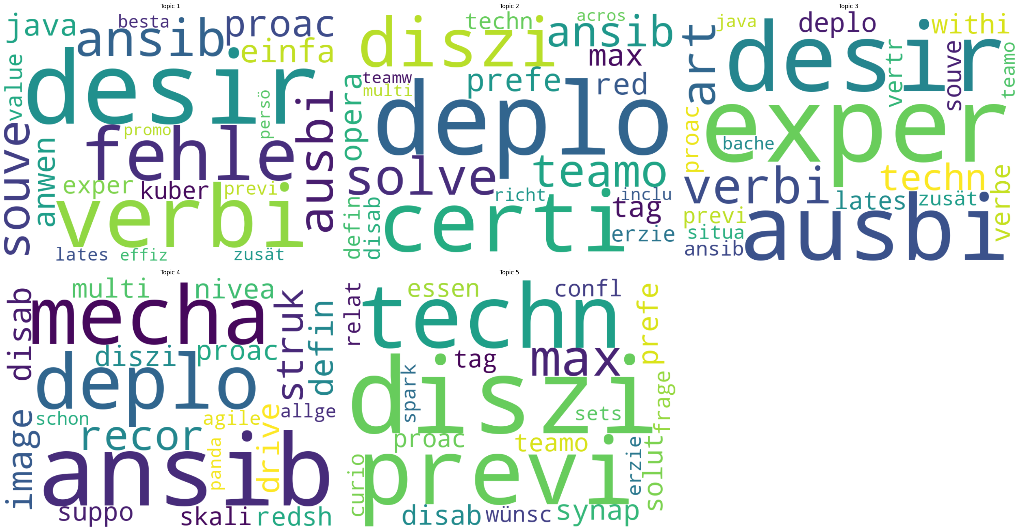
Job Description
Latent Dirichlet Allocation (LDA)

Slide 12
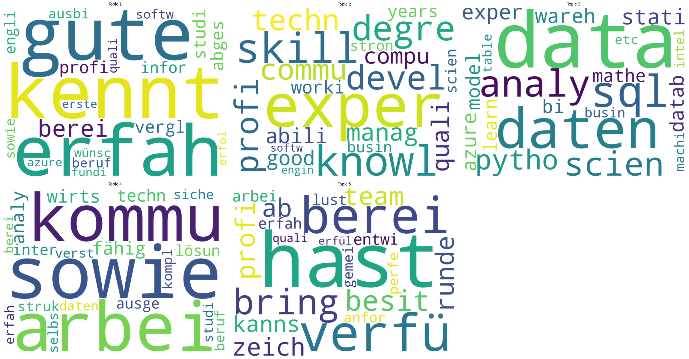
Job Requirement
Wirtschaft? (business)
Erfahrung? (experience)
Non-negative Matrix Factorization (NMF)

Slide 13
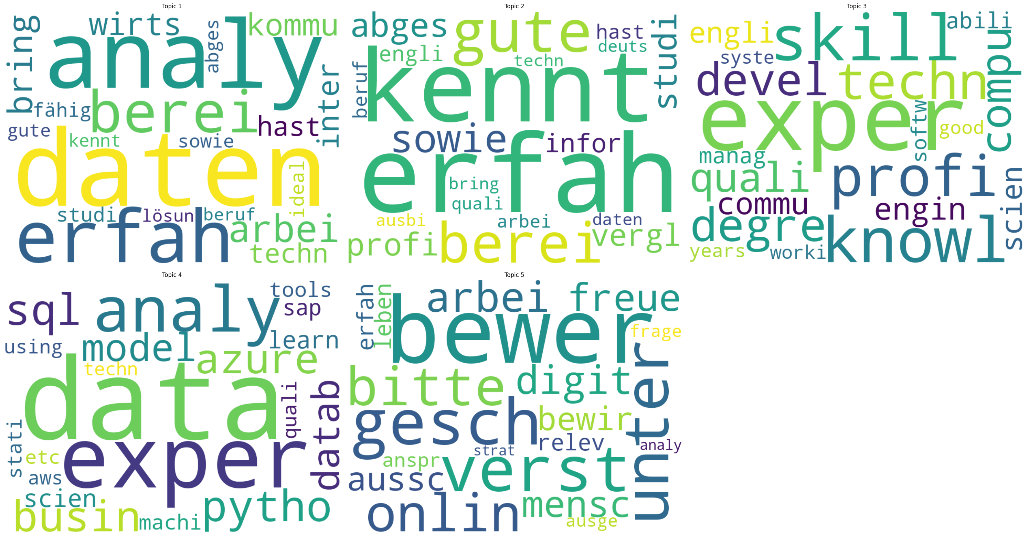
Job Requirement
English?
Latent Dirichlet Allocation (LDA)

Slide 14

Q&A

